Slide 1
OPS245 Week 12
Jonathan.ye@senecacollege.ca
Notes:
We will have test 2 next week. To accommodate students’ busy schedule, the test 2 will be available to your in a 24-hour window. And, you can start the 2 parts in any sequence take rest between the two parts. We will not have lecture tonight. Wish to post questions so as to invite you having a self-test when you can.

Slide 2
Introduction
In this lesson you will learn how to configure a Dynamic Host Control Protocol (DHCP) server for your network.
This will allow you to control the ip addresses assigned in your network and give you more practice configuring common services.
Notes:
We have two options on computers:
DHCP client – zero configuration and computers / devices get IP address from DHCP server automatically.
Manually assign static IP address.
That is what we did in lab 5.

Slide 3
What is DHCP?
DHCP stands for Dynamic Host Configuration Protocol.
It allows network devices (computers, printers, smart phones, etc.) to be automatically configured so they can communicate over the network.
This automatic configuration will assign devices an IP address, subnet, gateway, DNS, and other information.

Slide 4
DHCP vs. Static Networks
DHCP is served from a central location. In addition to simplifying configuration, DHCP also keeps track of IP addresses that are given out to devices on your network.
This prevents two devices from having the same address, something that can happen if you aren’t careful when using static network configuration.
It’s also useful for roaming, or mobile-type devices. A laptop used at work and home would be a pain to reconfigure every time you go from one to another. DHCP does this for you.

Slide 5
How Does DHCP Work?
When a device, set to use DHCP connects to a network, it sends out a general broadcast message asking for network configuration information. This goes out to all devices on the physical network but is ignored by all but the DHCP server.
This transmission uses MAC addressing to start things off, as the connecting device doesn’t yet have an IP address. (The MAC address is the physical address assigned to network cards when they’re manufactured.)
In Lab 8, we’re going to set up a DHCP server.

Slide 6
Address Allocation
IP address allocation is what we call an address that has been assigned to a client by the DHCP server. The server has a pool of addresses and assigns one that’s free.
There are two types of allocation:
Automatic - The server assigns an IP address to a MAC address. Once associated, it is permanent.
Dynamic - The server assigns an IP address to a MAC address using DHCP leasing. This sets a timer for how long a MAC address can use an assigned IP. It can be renewed infinitely, but if the client doesn’t renew, the IP address is removed and added back to the pool.
Unless told otherwise, always use dynamic address allocation.

Slide 7
DHCP: 4-Way Handshake
The acronym DORA is an easy way to remember how the DHCP handshake works:
Discovery: The client broadcasts a message (IP lease request) on a sub-network to discover available DHCP servers.
Offer: The DHCP server receives the request from the client, reserves an IP address for the client, and sends a DHCPOFFER.
Request: The client receives the offer, and sends a request asking to be assigned that offered IP address.
Acknowledgement: The DHCP server receives the request and sends the client an acknowledgement that they can use that IP address. The client then applies this address to itself.
Notes:
If the computer renews IP address, two steps: Request and Acknowledgement.
If the computer is brough to another network, 6 steps: Request, Nack (because the old IOP was not understood by the DHCP server in 2nd network), DORA then.

Slide 8
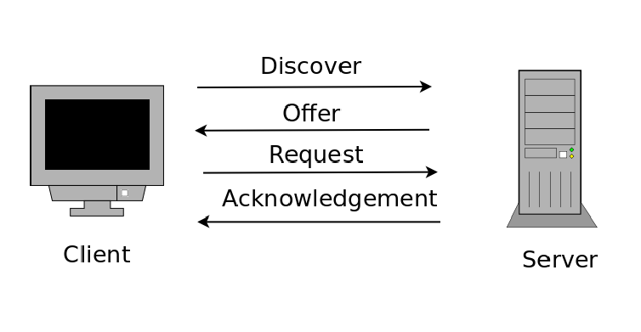
DHCP: 4-Way Handshake
Notes:
This is the IPv4 process. Find out IPv6 process by yourself.

Slide 9
Setting up a DHCP Server
Depending on your Linux installation, the DHCP server package may already be installed. On CentOS, this package is simply called “dhcp”. Other Linux distros may use a different package name.
To check if the DHCP service (dhcpd) is installed:
rpm -qa dhcp
yum info dhcp
If it isn’t installed, do so by running:
yum install dhcp -y

Slide 10
Setting up a DHCP Server Cont.
The main configuration file you’ll be working with can be found at:
/etc/dhcp/dhcpd.conf
Generally, this contains:
Global Settings: Options that apply throughout the entire network
Subnet Declarations: Options that apply only to that subnet
Like our SSH server, any changes made to this file will only be applied once the dhcp service is restarted.
systemctl restart dhcpd

Slide 11
DHCP: Global Options
Common global options:
IP address range - Allows you to specify the range of addresses for your DHCP pool (start and end addresses).
Lease duration - Set the default and maximum lease time for clients.
Router (default gateway) - Optional setting for the default gateway for your clients.
Domain Name and DNS servers - Optional setting to assign the parent domain and the addresses of DNS servers to the client.

Slide 12
DHCP: Lease Duration
Lease duration refers to the amount of time an IP address is paired with a device.
Once that time passes, one of two things can happen:
The client device has asked to renew its lease (resetting the counter)
No renewal is requested
If there has been no renewal, the IP address is disassociated with the MAC address and returned to the pool of available addresses.

Slide 13
Controlling Lease Duration
The two main types of lease duration settings are:
default-lease-time: If the client doesn’t specify duration during the handshake, it’s given this time
max-lease-time: If the client does specify duration, this is the maximum amount of time it can ask for.
Lease time is written in seconds.

Slide 14
DHCP Troubleshooting
Troubleshooting DHCP daemon is an important part of working with the service. If you’ve made changes to the configuration file and restarted, your first step is to check that the service is running properly.
Check status:
systemctl status dhcpd
Watch dhcpd status messages in real-time:
tail -f /var/log/messages
The most common problem with DHCPd is typos in the config file. Pay special attention to semicolons! They matter!
As an administrator, one of the most common issues you will encounter on a regular basis is typos. Seemingly minor things can break a service.

Slide 15
Troubleshooting Cont.
There are other files you can check when troubleshooting:
/var/lib/dhcpd/dhcpd.leases - This file is on the server and holds a record of leased addresses. If the service (or server computer) is restarted, it reads this file to know what’s been assigned.
/var/lib/dhclient/ - This directory on the client stores its records of leases.

Slide 16
DHCP Client Control
On your client machine, there are three ways to get it to run through the 4-way DHCP handshake.
A system reboot
Bringing an interface down, then up again
Running this command: dhclient
In your previous lab, you set your VMs to use static network configuration. Make sure to change them back to DHCP as Lab 8 tells you.

Slide 17
DHCP Static Addressing
There’s actually a third type of IP address allocation a DHCP server can provide. Fixed addressing (or reservations in Windows) allows you to associate a particular IP address with a particular device.
This is similar to what you did in Lab 7 with static network configuration. The difference here is you’re specifying network information using the DHCP server.
The device that’s assigned a fixed address still goes through the DHCP handshake process.
You’ve just created an entry that specifies a request coming from a certain MAC address always gets the same IP address.

Slide 18
Troubleshooting Process
Generally, troubleshooting consists of three basic elements:
Gathering information (e.g. finding out what was recently changed on the machine. What is its current state?).
Eliminating things the problem is NOT.
Having tenacity and patience
Solving a problem could take hours. May require delving into documentation.
Notes:
Keep and copy the slide here to remind you the general steps. Other related considerations:
if the dhcp server service is up
if the dhcp server is reachable
if there is any free address in the pool.
any network change

Slide 19
Summary
In this lesson you have learned how to configure common settings for a DHCP server and continued to practice common skills you will use for every service you ever work with.

Slide 20
Information sources
Google
Youtube
Wiki
Vendors’ site such as Python.org
And, what else? ☺

Slide 21
Question
Any question?
☺
Notes:
Practice is the key to learn and build muscle memory.

